Slide 1
History of Lowell
LOWELL, IN
FOUNDED 1852

Slide 2
Native Americans
Before hardy pioneers arrived, very few white men were in the area. The French were here as early as 1679, and, of course, the Indians, especially the Potawatomi Tribe, who had been here for many years before. Other tribes of Native Americans also lived in our area.
http://www.native-languages.org/indiana.htm

Slide 3
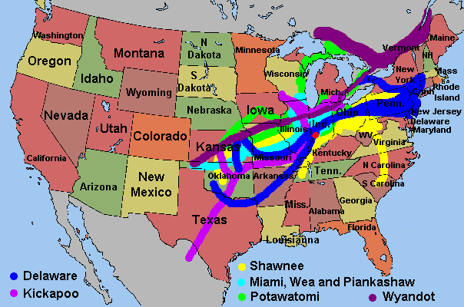

Slide 4
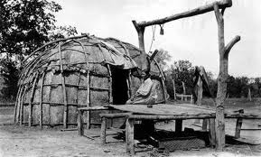
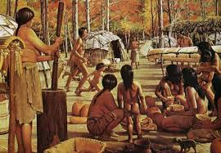
Potawatomi Indian House

Slide 5
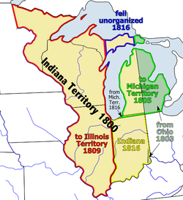
Indiana became an organized territory in 1800, and a state in 1816. After the treaty with the Indians the final purchase of the land took place in 1832. After surveying was completed in 1834, the homesteaders came.

Slide 6
Early Settlers of Lowell Area
It was October 1834, a month of good sunshine, when these pioneers started to come to our county with their white covered wagons, horses and oxen. One of these early settlers had this to say about his arrival in the area: “It was October 1834 when I first entered the Grand Prairie. It was about noon of a clear delightful day when we emerged from the wood, and for miles around stretched forth one broad expanse of clear open land.”
He also wrote that he could see in the distance the pretty groves where they later would build their cabins.

Slide 7
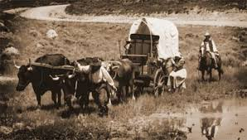

Slide 8
The first of the homesteaders in this part of Lake County was Thomas Childers, who, with his wife Sarah and their family, settled in School Grove early in October 1834. To be the first arrival was harder as settlers always helped to build cabins for their neighbors.
The Childers cabin was about two miles north of Schneider. All of these brave people bore their hardships with great cheerfulness, but the early years were hard times.

Slide 9
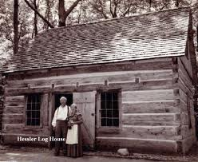
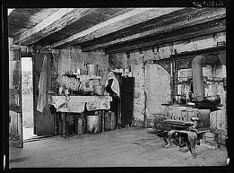

Slide 10
The winter of 1834 the Childers family was in School Grove; John Driscoll near Lowell; Jesse Pierce at Deep River and David Pierce at Turkey Creek with a few other scattered in the northern part of our county. They found the winter a terrible one. The oxen were hungry, food for the children became scarce and the flour mills were forty miles away in LaPorte County.
One family made a supper of a big owl and were roasting a wolf when a supply finally arrived. All game seemed to have hidden from the hunters guns.
Though they were hungry, no settlers starved and not one died the first bad winter in this area. They recorded in their logs the following: “1834-1835 exceedingly severe weather, and on April 4, 1835 a most terrible snowstorm.”

Slide 11
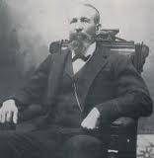
The winter of 1834 the Childers family was in School Grove; John Driscoll near Lowell; Jesse Pierce at Deep River and David Pierce at Turkey Creek with a few other scattered in the northern part of our county. They found the winter a terrible one. The oxen were hungry, food for the children became scarce and the flour mills were forty miles away in LaPorte County.
One family made a supper of a big owl and were roasting a wolf when a supply finally arrived. All game seemed to have hidden from the hunters guns.
Though they were hungry, no settlers starved and not one died the first bad winter in this area. They recorded in their logs the following: “1834-1835 exceedingly severe weather, and on April 4, 1835 a most terrible snowstorm.”
Melvin Halsted
Founder of Lowell

Slide 12
In 1845, Melvin and his wife Martha moved to Lake County, Indiana, and settled on an eighty-acre farm about five miles west of Lowell on Belshaw Road. No one can tell the story of their early life in the West Creek settlement better than Melvin Halsted himself, and the following is part of a story written by him August 31, 1905: (quote):

Slide 13
"In the early fall of 1844, I, M.A. Halsted, came, with my young family to Lake County, Indiana, on a visit, and was so pleased with the new country that I lost no time after I had gone back to Dayton, Ohio, in selling my farm and stock and getting ready to move. I was compelled to move by team as that was the only transportation in those days; the railroad not even coming to Chicago until eight years after that time. At this time there was not even one-tenth of the land bought of the government, so I purchased an eighty-acre deeded farm all fenced and plowed for $500.00.

Slide 14
In 1848, Halsted and his partner, O.E. Haskin, built a water-powered saw mill in the area to become the Town of Lowell, and in 1849 moved his family from the West Creek farm to a cabin near the present railroad depot in Lowell.
That same year he began to build what is now known as the "Halsted House" at the northeast corner of Halsted and Main Streets in Lowell. The house was finished in the spring of 1850. Halsted burned 400,000 bricks to build the home, which was a mansion in its day and quite different from the home of logs described in his article of 1905.

Slide 15
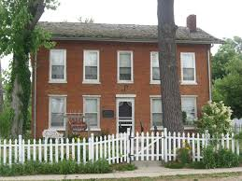
“
The Halsted House

Slide 16
Melvin Halsted was very important to Lowell.
*Built a saw mill in town
*Built a brick kiln
*Built flour mill
*Built brick church
*Helped bring a stagecoach route between Lowell and Crown Point. It carried mail and passengers. A one-way trip took 2 hours!
*Built two-story brick school house
*Helped bring the railroad to Lowell. There were passenger and freight trains that traveled to Chicago.

Slide 17
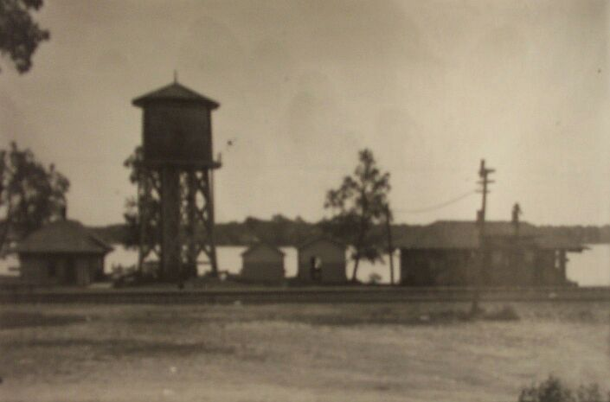
Railroad Station 1800s

Slide 18
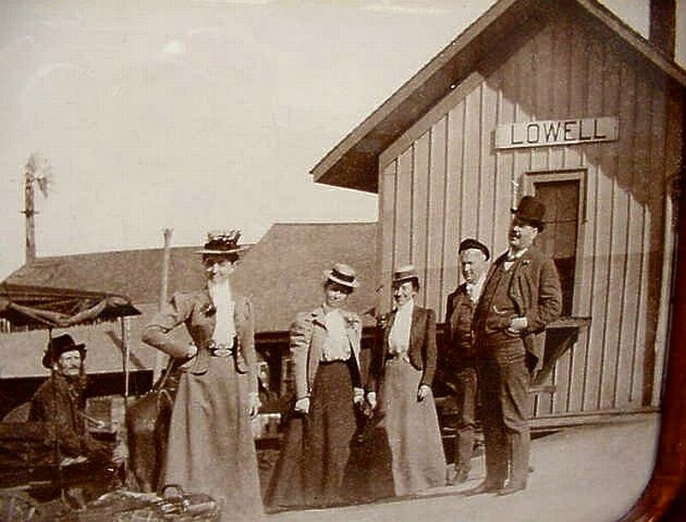
Lowell Train Station 1890

Slide 19
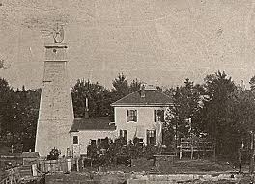
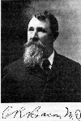
Dr. Bacon
Lowell’s Doctor
The Bacon Mansion

Slide 20
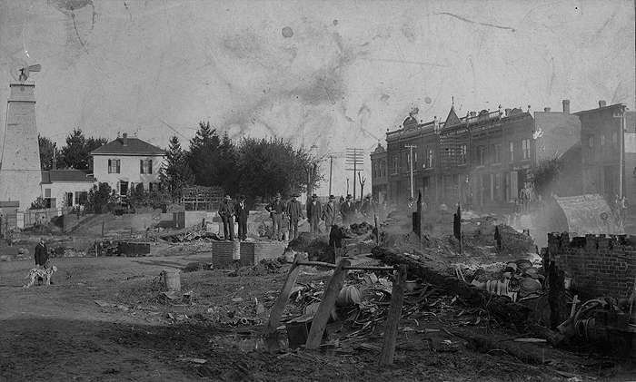
Lowell Fire 1898

Slide 21
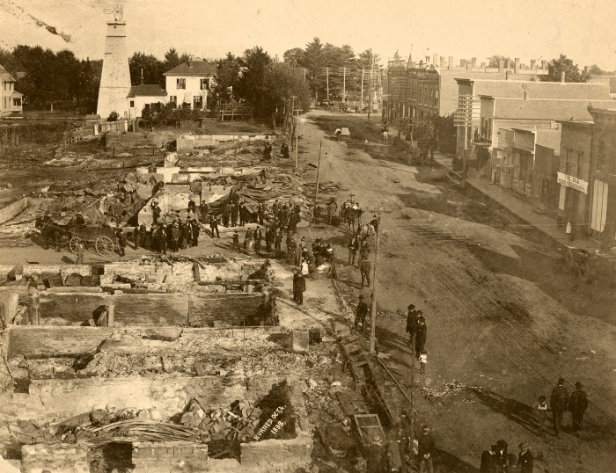
Lowell Fire 1898

Slide 22
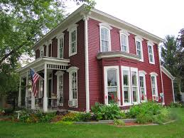
The Bacon Mansion Today

Slide 23
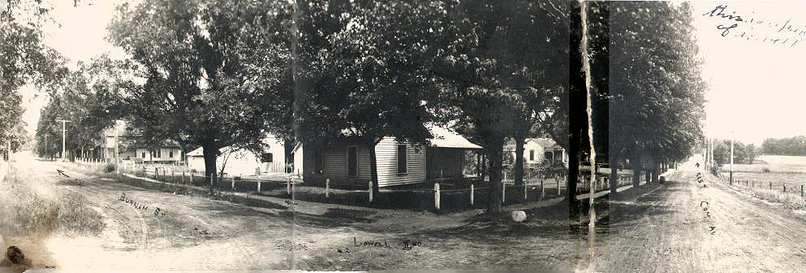
More Pictures of Lowell in the Past

Slide 24
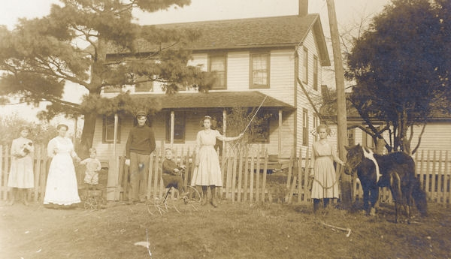
Buckley family 1900s

Slide 25
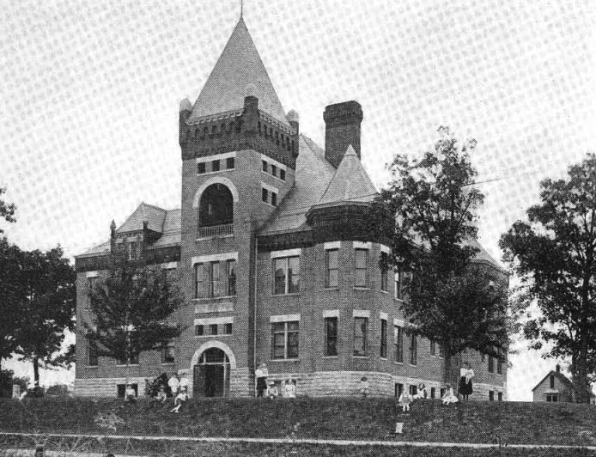
Lowell High School 1900

Slide 26
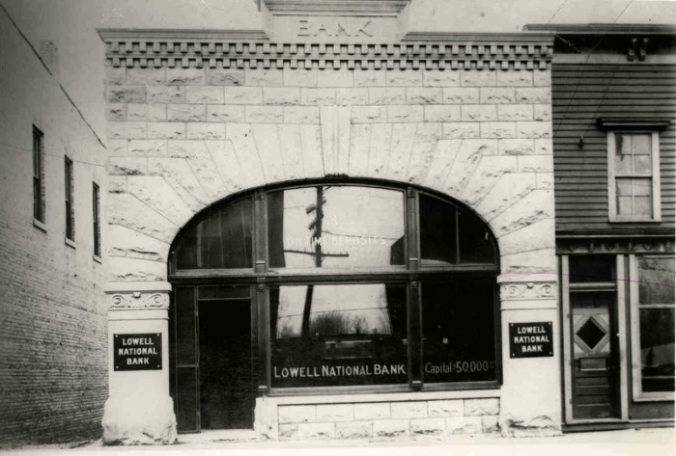
Lowell Bank 1900

Slide 27
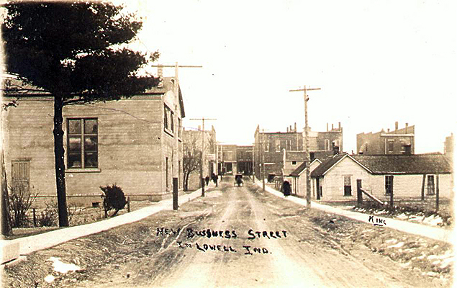
Lowell Street 1902

Slide 28
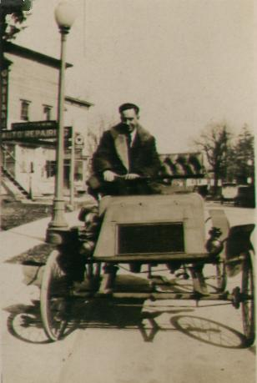
Lowell Man 1902

Slide 29
Lowell Street 1905

Slide 30
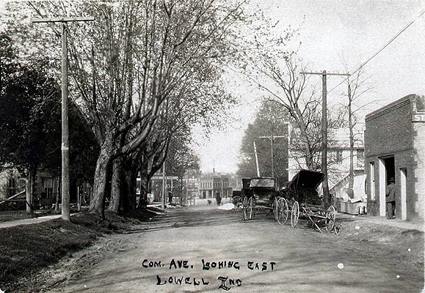
Lowell Street 1905

Slide 31
Lowell Street 1905

Slide 32
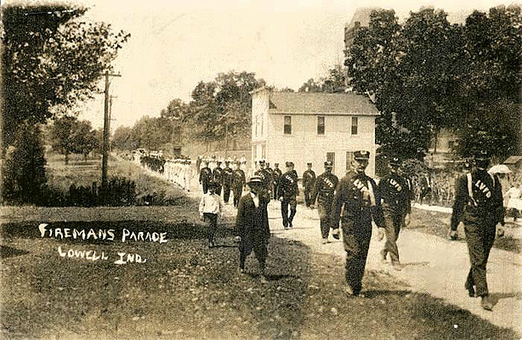
Lowell Fireman Parade 1907

Slide 33
Lowell Street 1910

Slide 34
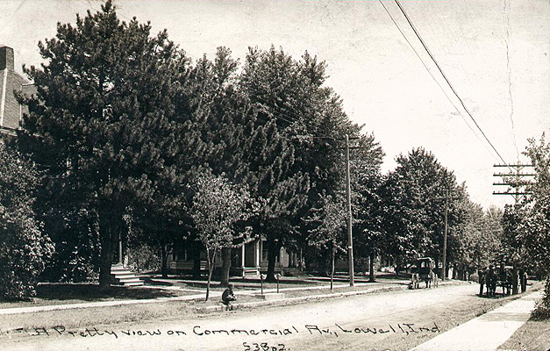
Lowell Street 1911

Slide 35
Lowell Street 1911

Slide 36
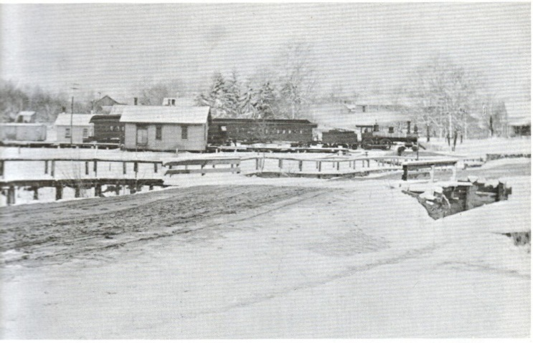
Milk Train Stopped for Delivery

Slide 37
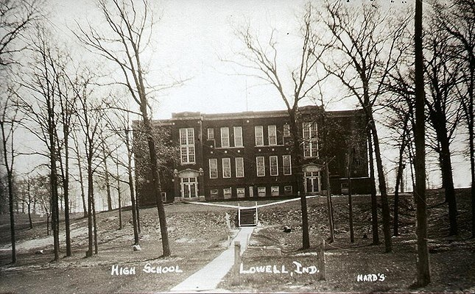
Lowell High School 1920

Slide 38
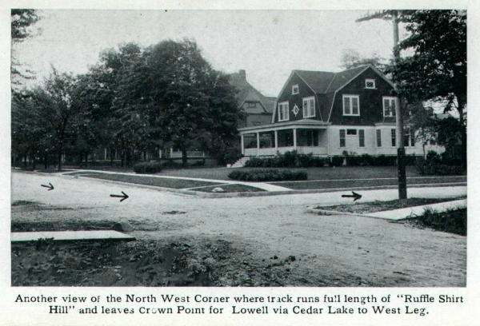
Cobe Cup 1900s

Slide 39
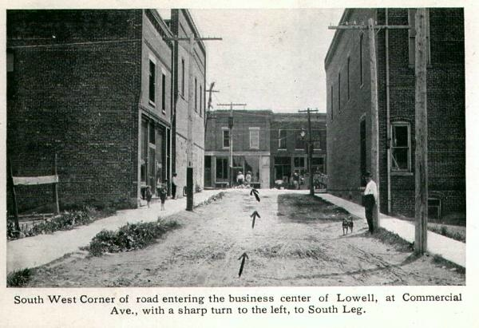
Cobe Cup 1900s

Slide 40
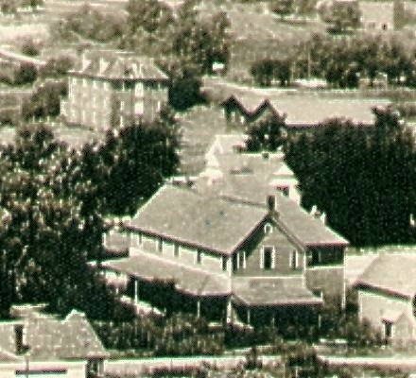
Aylea Hotel 1912

Slide 41
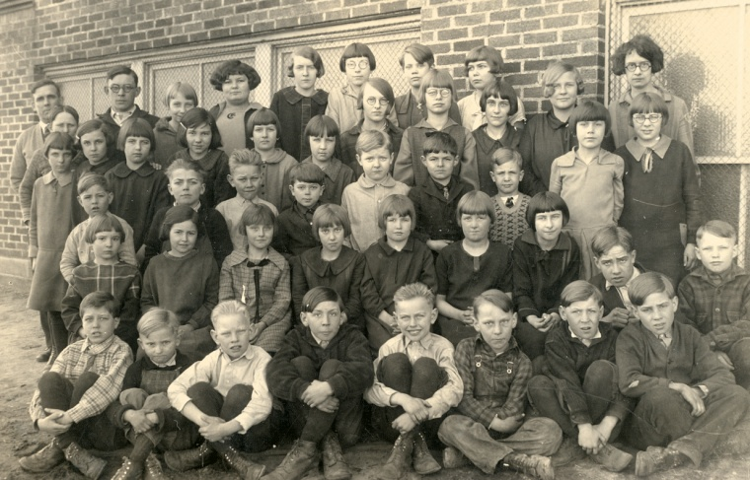
1912 Lake Prairie Elementary Students

Slide 42
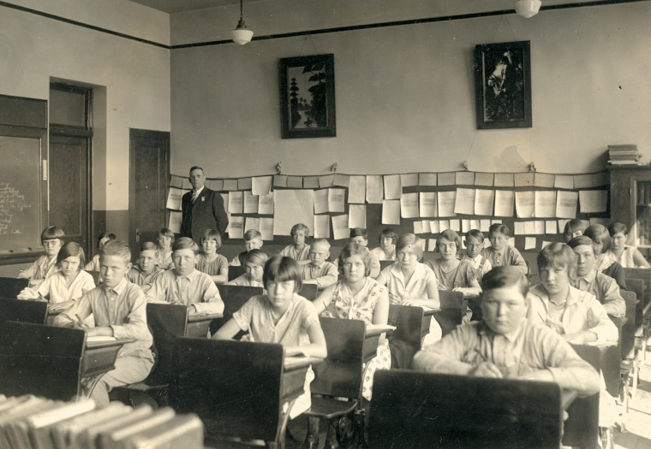
Lake Prairie Classroom 1912

Slide 43
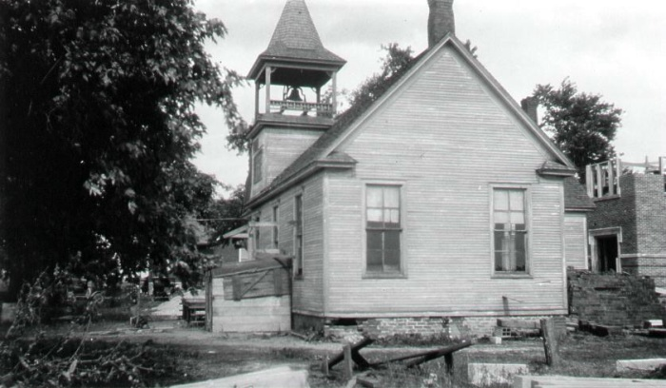
Lake Prairie Elementary School 1922

Slide 44
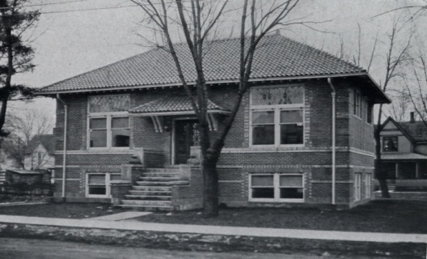
Lowell Library 1922

Slide 45
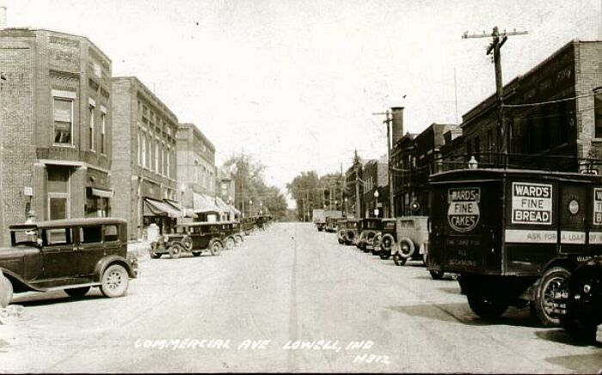
Downtown Lowell 1925

Slide 46
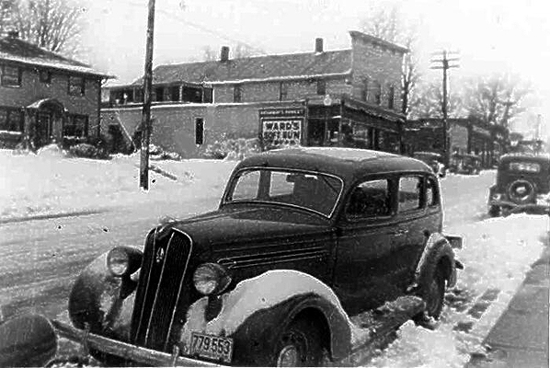
Downtown Lowell 1939

Slide 47
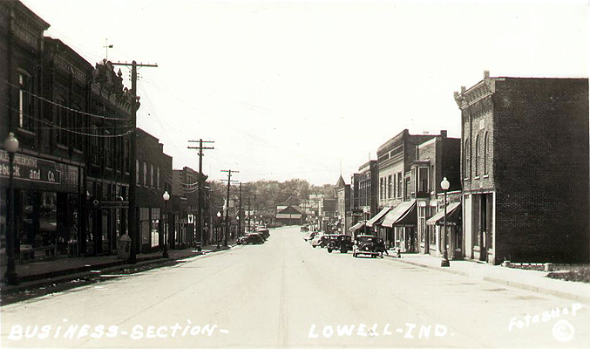
Lowell Street 1939

Slide 48
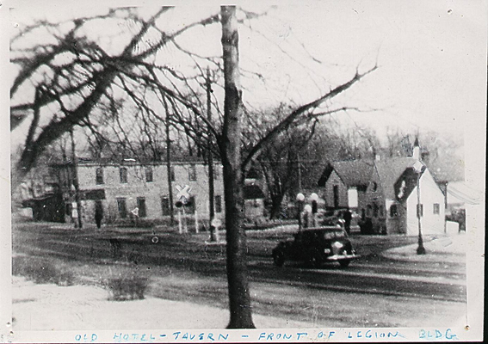
Lowell 1942

Slide 49
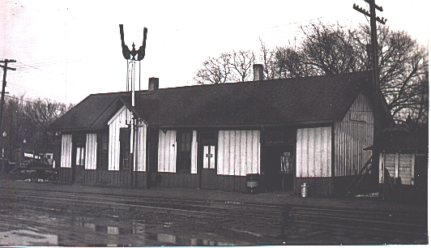
Old Lowell Train Station Building 1943

Slide 50
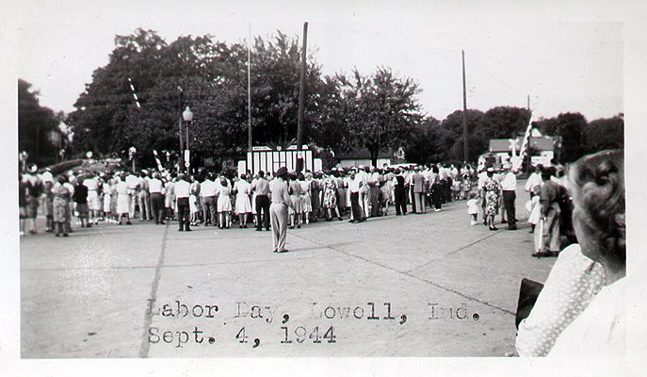
Labor Day Parade 1944

Slide 51
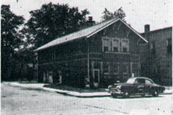
Lowell Town Hall 1952

Slide 52
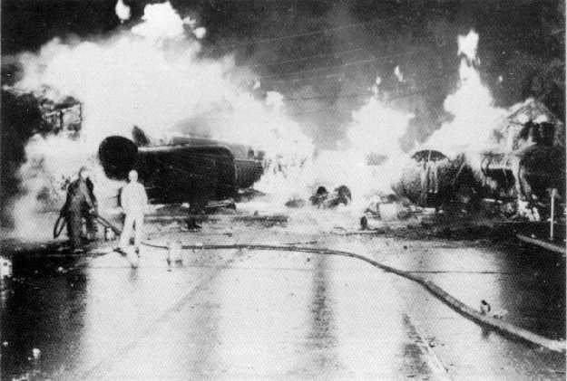
Train Wreck of 1952

Slide 53
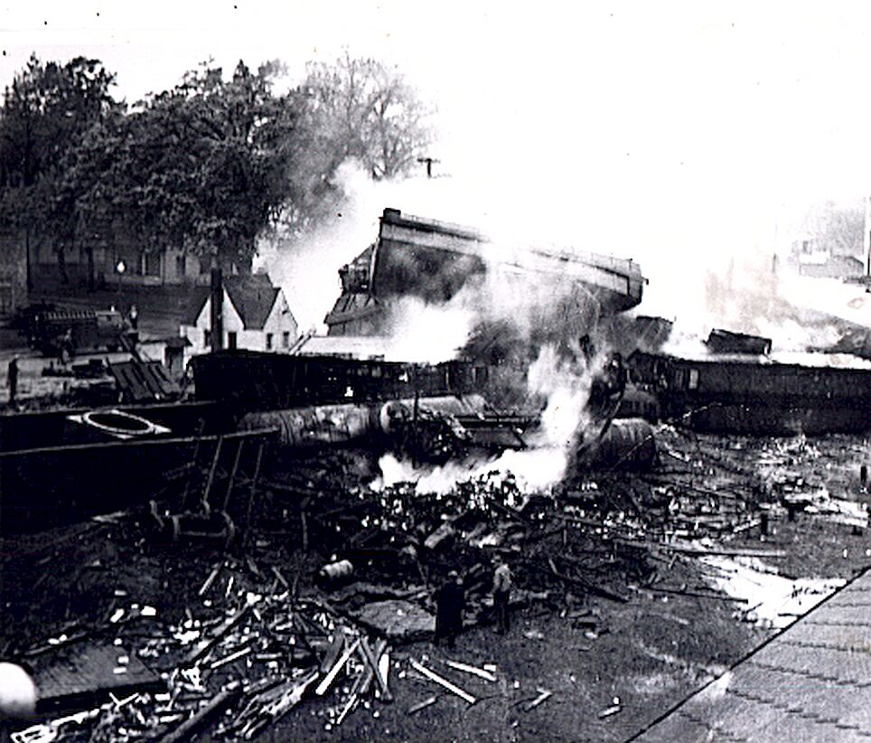
Train Wreck 1952

Slide 54
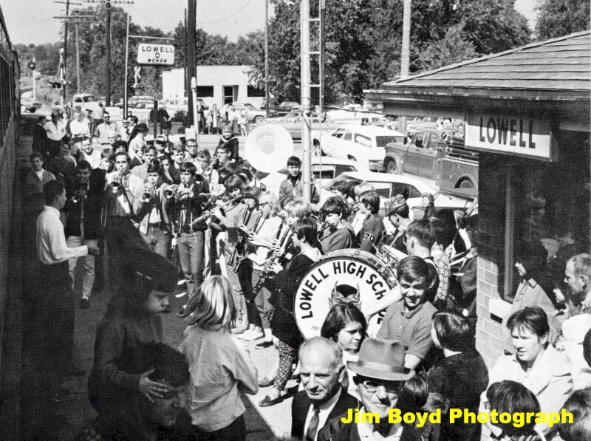
The Last Passenger Train Stopped 1967

Slide 55
To be continued………. ;)

